Slide 1
Understanding weather data
Maths and the environment

Slide 2
How our teaching resources are designed for the classroom

Slide 3
I can interpret a weather report.

Slide 4
A forecast is a prediction of a future event occurring (based on data).

Slide 5

Understanding weather data
Understanding a basic weather forecast
Analysing extra forecast information

Slide 6








Understanding a basic weather forecast
Most weather forecasts use different symbols to represent different types of weather.
What do you think these weather symbols mean?
a)
b)
c)
d)
lightning
windy
cloudy
snow
e)
f)
g)
h)
sunny
sunny intervals
rain showers
heavy rain

Slide 7


Understanding a basic weather forecast
When might you see these two weather symbols, and which other symbols would they replace?
These weather symbols will replace any symbol involving the Sun if the forecast shows the weather at night.
clear sky at night
clear sky intervals at night
sunny
sunny intervals
rain showers
heavy rain

Slide 8
Understanding a basic weather forecast
A forecast is a prediction of a future event occurring (based on data).
fore cast
before
plan
A weather forecast is a prediction of future weather conditions based on data collected on atmospheric conditions, as well as historical weather information.

Slide 9
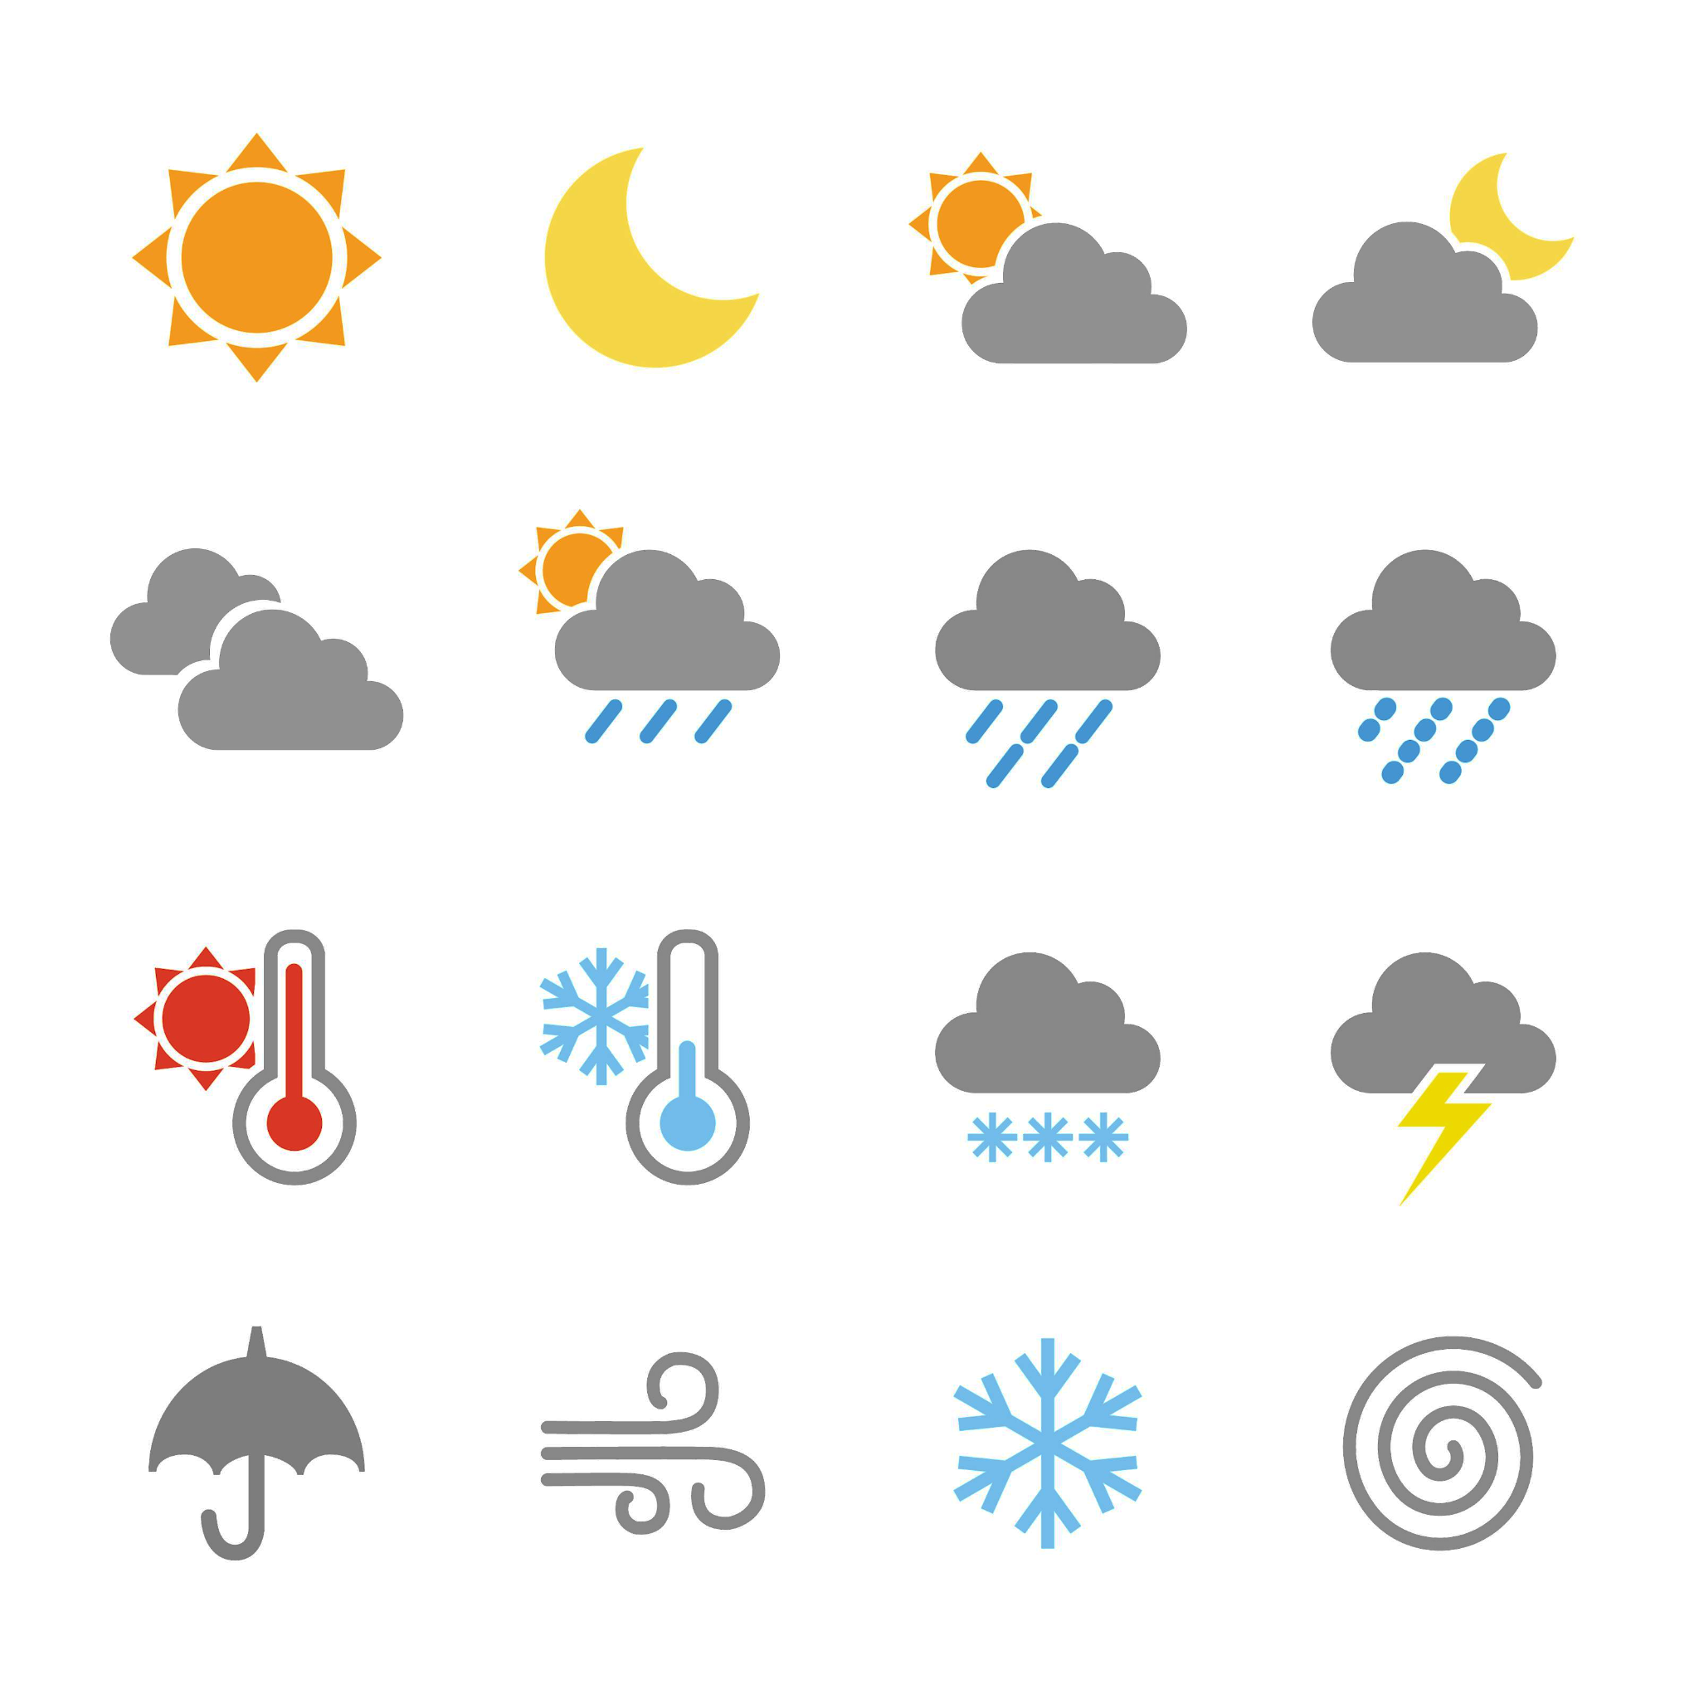
Understanding a basic weather forecast
There are two common ways to see a weather forecast.
A weather report
06:00 | 09:00 | 12:00 | 15:00 | 18:00 | 21:00
9°C | 10°C | 13°C | 12°C | 11°C | 10°C
18°C
16°C
19°C
17°C
17°C
A weather map

Slide 10
Understanding a basic weather forecast
Weather reports are a great way of assessing weather conditions in one location over a period of time (such as one day or across multiple days).
Different weather reports will give different levels of information, but you will usually see…
time
00:00 | 03:00 | 06:00 | 09:00 | 12:00 | 15:00 | 18:00 | 21:00
7°C | 5°C | 9°C | 10°C | 11°C | 12°C | 12°C | 10°C
weather conditions
temperature
weather in “Oakfield Old Town”

Slide 11
Understanding a basic weather forecast
A weather forecast will show the expected weather at a certain time.
Weather conditions at any other time (not on the forecast) can be anything. However, it is usually one of the weather conditions at the time on the report either just before or just after that time.
00:00 | 03:00 | 06:00 | 09:00 | 12:00 | 15:00 | 18:00 | 21:00
7°C | 5°C | 9°C | 10°C | 11°C | 12°C | 12°C | 10°C
At 10 am, the weather will likely be either sunny intervals or rain showers, and at a temperature between 10°C and 11°C.
weather in “Oakfield Old Town”
For example, the weather at 9 am is sunny intervals, and the weather at 12 pm is rain showers.
The rain showers will begin at some time in between 9 am and 12 pm.

Slide 12
Understanding a basic weather forecast
Complete these two sentences.
The temperature at 3 am will be 5°C .
The temperature at 3 am will be ___________ .
The temperature at 4:30 am is likely to be between 5°C and 9°C .
The temperature at 4:30 am is likely to be between ___________________ .
00:00 | 03:00 | 06:00 | 09:00 | 12:00 | 15:00 | 18:00 | 21:00
7°C | 5°C | 9°C | 10°C | 11°C | 12°C | 12°C | 10°C
weather in “Oakfield Old Town”

Slide 13
Understanding a basic weather forecast
What are the weather conditions likely to be at 7 pm?
Either sunny or rain showers.
00:00 | 03:00 | 06:00 | 09:00 | 12:00 | 15:00 | 18:00 | 21:00
7°C | 5°C | 9°C | 10°C | 11°C | 12°C | 12°C | 10°C
weather in “Oakfield Old Town”

Slide 14
Understanding a basic weather forecast
Between which two times is sunrise?
Explain how you know.
00:00 | 03:00 | 06:00 | 09:00 | 12:00 | 15:00 | 18:00 | 21:00
7°C | 5°C | 9°C | 10°C | 11°C | 12°C | 12°C | 10°C
weather in “Oakfield Old Town”
Between 6 am and 9 am.
This is because at 6 am the weather shows clear sky intervals without the Sun, whilst at 9 am it shows clear sky intervals with the Sun.

Slide 15
Understanding a basic weather forecast
Weather maps are a great way of assessing weather conditions across multiple locations at one point in time.
Oakfield
18°C
Different weather maps will give different levels of information, but you will usually see…
16°C
19°C
Oakfield
Academy
weather conditions
16°C
Oakfield
Harbour
temperatures
15°C
17°C
Oakfield
Old Town
N
Oakmoor
15:00

Slide 16
Understanding a basic weather forecast
Weather maps can be used to compare weather conditions across a larger area, and assess what sort of trends might be present.
Oakfield
18°C
19°C
For example
At 3 pm, the weather in Oakfield is warmer to the east, and cooler to the west.
16°C
Oakfield
Academy
16°C
Oakfield
Harbour
Towards the north east of Oakfield, the weather is sunny. However, towards the west of Oakfield, the weather is cloudy with rainfall.
15°C
17°C
Oakfield
Old Town
N
Oakmoor
15:00

Slide 17

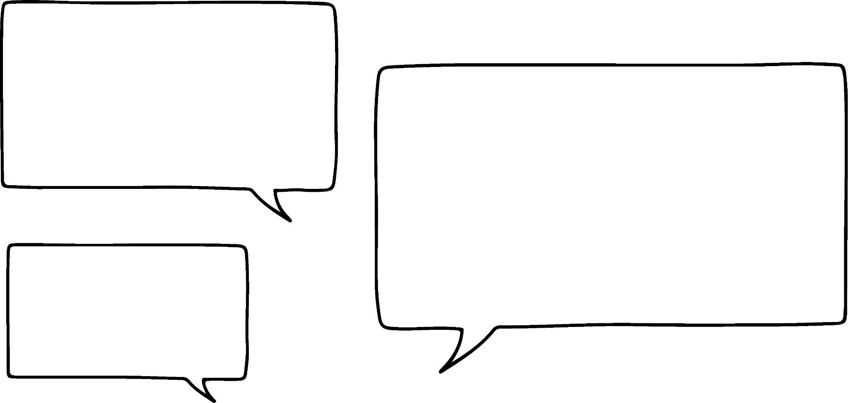



Understanding a basic weather forecast
Whose statement about the weather is correct?
Aisha
There is rain in north-east Oakfield.
Oakfield
12°C
13°C
10°C
Oakfield
Academy
Laura
14°C
There is rain at Oakmoor.
Oakfield
Harbour
14°C
15°C
Lucas
The temperatures of south Oakfield are warmer than north Oakfield.
Oakfield
Old Town
N
Oakmoor
17:00

Slide 18
Understanding a basic weather forecast
Which location shows the greatest change in temperature from 3 pm to 5 pm?
Oakfield
12°C
Oakfield Academy | 16°C
Oakmoor | 15°C
Oakfield Old Town | 17°C
Oakfield Harbour | 19°C
13°C
10°C
Oakfield
Academy
14°C
Oakfield
Harbour
Temperatures in Oakfield at 15:00
14°C
15°C
Oakfield Harbour
Oakfield
Old Town
N
Oakmoor
17:00

Slide 19
Understanding a basic weather forecast
Oakfield Old Town had the largest decrease in temperature from 3 pm to 11 pm. Suggest a possible temperature at Oakfield Old Town at 11 pm.
Oakfield
11°C
Oakfield Academy | 16°C
Oakmoor | 15°C
Oakfield Old Town | 17°C
Oakfield Harbour | 19°C
9°C
8°C
Oakfield
Academy
10°C
Oakfield
Harbour
Temperatures in Oakfield at 15:00
7°C
???
Oakfield
Old Town
Any temperature under 6°C, such as: 5.5°C or 2°C.
N
Oakmoor
23:00

Slide 20
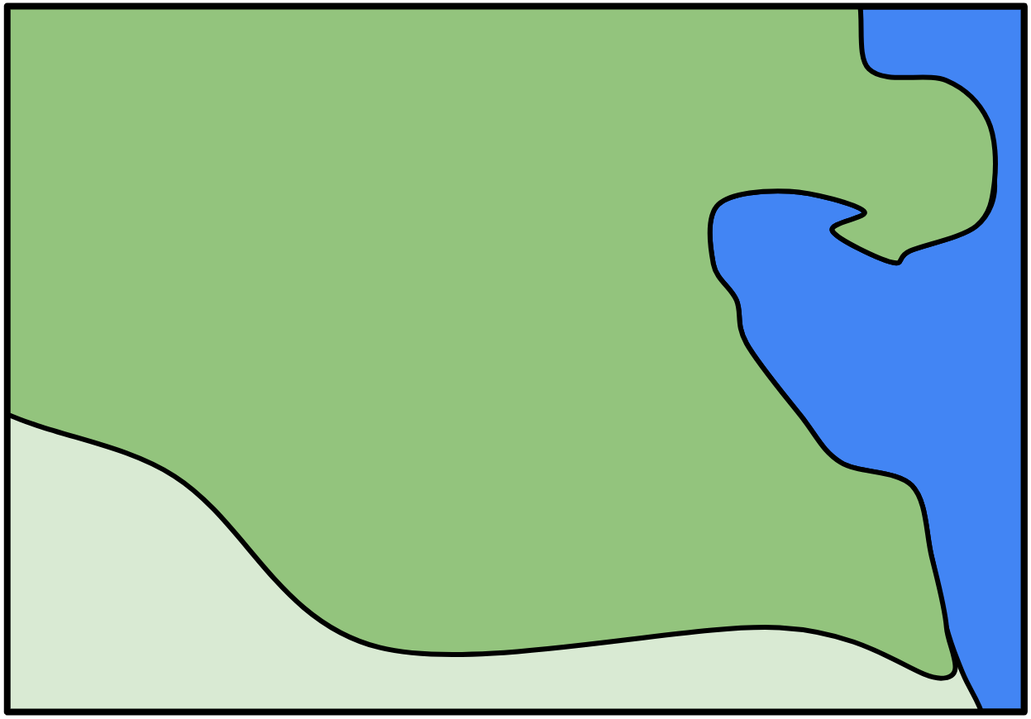
Understanding a basic weather forecast
1) At 8 am, Sofia cycles to Oakfield Academy from her house near the Old Town. The dotted line shows Sofia’s route.
Oakfield
11°C
Sofia has the following items. Which should she bring for her journey to Oakfield Academy? Justify your answer for each one.
12°C
7°C
Oakfield
Academy
9°C
Oakfield
Harbour
sunglasses (for constant sunny weather)
raincoat (for any amount of rain)
scarf (if the temperature drops below 10°C)
8°C
10°C
Oakfield
Old Town
N
Oakmoor
08:00

Slide 21
Understanding a basic weather forecast
2) This weather report shows weather data for 1st June 2024.
00:00 | 02:00 | 04:00 | 06:00 | 08:00 | 10:00 | 12:00 | 14:00
9°C | 10°C | 8°C | 10°C | 13°C | 12°C | 11°C | 12°C
weather at “Oakfield Harbour”
a) Between which two times is sunrise?
b) Describe the trend in the weather conditions between 8 am and 12 pm.
c) What is the mean temperature during the night-time hours?
d) Which of these weather conditions is likely at 1 pm? Justify your choices.
sunny
sunny intervals
rain showers
heavy rain
lightning

Slide 22
Understanding a basic weather forecast
00:00 | 03:00 | 06:00 | 09:00 | 12:00 | 15:00 | 18:00 | 21:00
6°C | 5°C | 9°C | 12°C | 13°C | 12°C | 10°C | 10°C
Weather report for a location in Oakfield.
Oakfield
12°C
3a) Which location in Oakfield does this weather report most likely represent?
b) What is the range of temperatures at this location?
c) The range of temperatures at location A is the same as the range in the report location. What are the maximum and minimum temperatures at location A?
13°C
10°C
A
Oakfield
Academy
8°C
Oakfield
Harbour
10°C
9°C
B
N
Oakmoor
Oakfield
Old Town
18:00

Slide 23
Understanding a basic weather forecast
1) At 8 am, Sofia cycles to Oakfield Academy from her house near the Old Town. The dotted line shows Sofia’s route.
Oakfield
11°C
Sofia has the following items. Which should she bring for her journey to Oakfield Academy? Justify your answer for each one.
12°C
7°C
Oakfield
Academy
9°C
Oakfield
Harbour
sunglasses (for constant sunny weather)
raincoat (for any amount of rain)
scarf (if the temperature drops below 10°C)
8°C
10°C
Oakfield
Old Town
N
Oakmoor
08:00

Slide 24
Understanding a basic weather forecast
Sofia should bring her raincoat, as she passes in between two locations that show rainfall.
Sofia should also bring her scarf, as in the locations with rainfall, the temperature drops below 10°C (at 8°C and 9°C).
Sofia does not need to bring sunglasses, as there are only sunny intervals at Oakfield Academy, not constant sun.
Oakfield
11°C
12°C
7°C
Oakfield
Academy
9°C
Oakfield
Harbour
8°C
10°C
Oakfield
Old Town
N
Oakmoor
08:00

Slide 25
Understanding a basic weather forecast
2) This weather report shows weather data for 1st June 2024.
00:00 | 02:00 | 04:00 | 06:00 | 08:00 | 10:00 | 12:00 | 14:00
9°C | 10°C | 8°C | 10°C | 13°C | 12°C | 11°C | 12°C
weather at “Oakfield Harbour”
a) Between which two times is sunrise?
b) Describe the trend in the weather conditions between 8 am and 12 pm.
Between 4 am and 6 am.
The rainfall increases from rain showers to heavy rain. The temperature also drops 2°C, from 13°C to 11°C.

Slide 26
Understanding a basic weather forecast
2) This weather report shows weather data for 1st June 2024.
00:00 | 02:00 | 04:00 | 06:00 | 08:00 | 10:00 | 12:00 | 14:00
9°C | 10°C | 8°C | 10°C | 13°C | 12°C | 11°C | 12°C
weather at “Oakfield Harbour”
c) What is the mean temperature during the night-time hours?
(9°C + 10°C + 8°C) ÷ 3 = 9°C

Slide 27
Understanding a basic weather forecast
2) This weather report shows weather data for 1st June 2024.
00:00 | 02:00 | 04:00 | 06:00 | 08:00 | 10:00 | 12:00 | 14:00
9°C | 10°C | 8°C | 10°C | 13°C | 12°C | 11°C | 12°C
weather at “Oakfield Harbour”
d) Which of these weather conditions is likely at 1 pm? Justify your choices.
Whilst the weather could be anything at 1 pm, it is likely to be either the weather at 12 pm (heavy rain) or the weather at 2 pm (sunny intervals), or a combination of both (rain showers).
sunny
sunny intervals
rain showers
heavy rain
lightning

Slide 28
Understanding a basic weather forecast
00:00 | 03:00 | 06:00 | 09:00 | 12:00 | 15:00 | 18:00 | 21:00
6°C | 5°C | 9°C | 12°C | 13°C | 12°C | 10°C | 10°C
Weather report for a location in Oakfield.
Oakfield
12°C
3a) Which location in Oakfield does this weather report most likely represent?
13°C
10°C
A
Oakfield
Academy
Oakmoor.
This is because both the report and map show heavy rain and a temperature of 10°C at 6 pm.
8°C
Oakfield
Harbour
10°C
9°C
B
N
Oakmoor
Oakfield
Old Town
18:00

Slide 29
Understanding a basic weather forecast
00:00 | 03:00 | 06:00 | 09:00 | 12:00 | 15:00 | 18:00 | 21:00
6°C | 5°C | 9°C | 12°C | 13°C | 12°C | 10°C | 10°C
Weather report for a location in Oakfield.
Oakfield
12°C
b) What is the range of temperatures at this location?
13°C
10°C
A
The range of temperatures in Oakmoor (from the weather report) is 13°C – 5°C = 8°C.
Oakfield
Academy
8°C
Oakfield
Harbour
10°C
9°C
B
N
Oakmoor
Oakfield
Old Town
18:00

Slide 30
Understanding a basic weather forecast
00:00 | 03:00 | 06:00 | 09:00 | 12:00 | 15:00 | 18:00 | 21:00
6°C | 5°C | 9°C | 12°C | 13°C | 12°C | 10°C | 10°C
Weather report for a location in Oakfield.
Oakfield
12°C
c) The range of temperatures at location A is the same as the range in the report location. What are the maximum and minimum temperatures at location A?
13°C
10°C
A
Oakfield
Academy
8°C
Oakfield
Harbour
12°C + 8°C = 20°C
or
12°C – 8°C = 4°C
10°C
9°C
B
N
Oakmoor
Oakfield
Old Town
18:00

Slide 31
Understanding weather data
Understanding a basic weather forecast
Analysing extra forecast information

Slide 32

Analysing extra forecast information
Is it really 16°C here at Oakfield Academy?
It feels a lot colder than that!
Oakfield
18°C
16°C
19°C
Oakfield
Academy
16°C
Oakfield
Harbour
15°C
Andeep
17°C
Oakfield
Old Town
N
Oakmoor
15:00

Slide 33
Analysing extra forecast information
The most common temperature shown on weather forecasts is the air temperature.
Oakfield
18°C
16°C
19°C
16°C
So, the 16°C at Oakfield Academy shows only the temperature of the outside air at 3 pm.
Oakfield
Academy
16°C
Oakfield
Harbour
15°C
17°C
What other weather factors could make the temperature feel colder than 16°C to Andeep?
Oakfield
Old Town
N
Oakmoor
15:00

Slide 34
Analysing extra forecast information
The difference between the air temperature and what the temperature actually feels like can be due to:
Oakfield
18°C
16°C
19°C
16°C
rainfall
wind-speed
wind direction
air pressure
humidity
Oakfield
Academy
16°C
Oakfield
Harbour
15°C
17°C
Oakfield
Old Town
N
Oakmoor
15:00

Slide 35
Analysing extra forecast information
The “feels like” temperature at Oakfield Academy might be lower due to the cold rain and winds.
Oakfield
Oakfield
18°C
18°C
19°C
16°C
16°C
12°C
Oakfield
Academy
Oakfield
Academy
16°C
14°C
Oakfield
Harbour
Andeep
Oakfield
Harbour
15°C
10°C
17°C
13°C
Even though the air temperature at Oakfield Academy is 16°C, it feels closer to 12°C due to the amount of cold rain and winds.
Oakfield
Old Town
Oakfield
Old Town
N
N
Oakmoor
Oakmoor
“Feels like” temperature
15:00
15:00
Weather images: Raura7/ Shutterstock.com

Slide 36
Analysing extra forecast information
Both a weather map and weather report can show extra information that gives more context about the weather conditions.
This extra information can help explain the difference between the air temperature and “feels like” temperature at any given time.
00:00 | 03:00 | 06:00 | 09:00 | 12:00 | 15:00 | 18:00 | 21:00
10°C | 9°C | 11°C | 14°C | 11°C | 11°C | 16°C | 10°C
wind speed (km/h)
wind direction
4 | 4 | 7 | 8 | 10 | 16 | 7 | 5
↗ | ↓ | ↓ | ↓ | ↙ | ↙ | ↗ | ↙
“feels like”
10°C | 7.5°C | 9°C | 11.5°C | 7°C | 5°C | 16°C | 8°C

Slide 37
Analysing extra forecast information
Sometimes, an increase in wind-speed may make the temperature feel colder.
On this weather report, an increase in wind-speed from 10 km/h to 16 km/h drops the “feels like” temperature by 2°C, even if the air temperature stays the same.
00:00 | 03:00 | 06:00 | 09:00 | 12:00 | 15:00 | 18:00 | 21:00
10°C | 9°C | 11°C | 14°C | 11°C | 11°C | 16°C | 10°C
wind speed (km/h)
wind direction
4 | 4 | 7 | 8 | 10 | 16 | 7 | 5
↗ | ↓ | ↓ | ↓ | ↙ | ↙ | ↗ | ↙
“feels like”
10°C | 7.5°C | 9°C | 11.5°C | 7°C | 5°C | 16°C | 8°C

Slide 38
Analysing extra forecast information
Sometimes, an increase in wind-speed may make the temperature feel colder.
Furthermore, wind from a south-westerly direction seems to have no influence on temperature, whilst winds from any northerly direction seems to reduce the “feels like” temperature.
00:00 | 03:00 | 06:00 | 09:00 | 12:00 | 15:00 | 18:00 | 21:00
10°C | 9°C | 11°C | 14°C | 11°C | 11°C | 16°C | 10°C
wind speed (km/h)
wind direction
4 | 4 | 7 | 8 | 10 | 16 | 7 | 5
↗ | ↓ | ↓ | ↓ | ↙ | ↙ | ↗ | ↙
“feels like”
10°C | 7.5°C | 9°C | 11.5°C | 7°C | 5°C | 16°C | 8°C

Slide 39
Analysing extra forecast information
At which time of day does the wind cause the greatest difference between air temperature and “feels like” temperature?
3 pm
00:00 | 03:00 | 06:00 | 09:00 | 12:00 | 15:00 | 18:00 | 21:00
6°C | 8°C | 10°C | 13°C | 17°C | 16°C | 15°C | 11°C
wind speed (km/h)
wind direction
7 | 7 | 10 | 12 | 14 | 16 | 15 | 10
↗ | ← | ← | ↗ | ← | ← | ↗ | ←
“feels like”
6°C | 6°C | 7°C | 12°C | 12°C | 10°C | 14°C | 8°C

Slide 40
Analysing extra forecast information
Which of the two wind directions in this weather report appears to have the most influence on the “feels like” temperature?
Easterly winds (winds from the east)
00:00 | 03:00 | 06:00 | 09:00 | 12:00 | 15:00 | 18:00 | 21:00
6°C | 8°C | 10°C | 13°C | 17°C | 16°C | 15°C | 11°C
wind speed (km/h)
wind direction
7 | 7 | 10 | 12 | 14 | 16 | 15 | 10
↗ | ← | ← | ↗ | ← | ← | ↗ | ←
“feels like”
6°C | 6°C | 7°C | 12°C | 12°C | 10°C | 14°C | 8°C

Slide 41
Analysing extra forecast information
Air pressures of different densities can also influence weather conditions.
Oakfield
13°C
A cold front is shown by a blue line and triangles.
The direction the triangles point in show the direction of dominant cold air that leads to colder temperatures and rainfall.
17°C
9°C
Oakfield
Academy
16°C
Oakfield
Harbour
18°C
12°C
Oakfield
Old Town
N
Oakmoor
10:00

Slide 42
Analysing extra forecast information
Air pressures of different densities can also influence weather conditions.
Oakfield
Locations influenced by cold fronts are more likely to result in rain.
The “percentage chance of rainfall” can also be shown on a weather map or weather report.
60%
15%
100%
Oakfield
Academy
10%
Oakfield
Harbour
< 5%
55%
Oakfield
Old Town
N
Oakmoor
10:00

Slide 43
Analysing extra forecast information
Air pressures of different densities can also influence weather conditions.
Oakfield
20°C
A warm front is shown by a red line and semicircles.
The direction the semicircles point in show the direction of dominant warm air that leads to hotter temperatures and clearer skies.
21°C
19°C
Oakfield
Academy
16°C
Oakfield
Harbour
17°C
14°C
Oakfield
Old Town
N
Oakmoor
16:00

Slide 44
Analysing extra forecast information
Oakfield
This weather map shows the “percentage chance of rainfall” in three different locations.
Write down suitable values for a and b.
b
Oakfield
Academy
65%
Oakfield
Harbour
a
a should be around 65%, whilst b should be a lot lower than 65%.
Oakfield
Old Town
N
Oakmoor
16:00

Slide 45
Analysing extra forecast information
Oakfield
Which of these locations is most likely to have a temperature of 25°C?
a) Oakfield Academy
b) Oakmoor
c) Oakfield Harbour
d) Oakfield Old Town
Oakfield
Academy
Oakfield
Harbour
23°C
Oakfield
Old Town
N
Oakmoor
16:00

Slide 46
Analysing extra forecast information
1) This weather report shows the weather forecast for Oakfield Harbour.
a) Which wind directions results in the most and least difference between air temperature and the “feels like” temperature?
b) A cold front will blow over Oakfield Harbour. Using the weather report, write down the most likely time this will happen, and justify your answer.
00:00 | 03:00 | 06:00 | 09:00 | 12:00 | 15:00 | 18:00 | 21:00
13°C | 15°C | 15°C | 22°C | 24°C | 18°C | 14°C | 12°C
air temperature
wind speed (km/h)
wind direction
2 | 5 | 7 | 3 | 8 | 14 | 11 | 2
↗ | ↑ | ↑ | ← | ← | ← | ← | ←
“feels like”
13°C | 14°C | 14°C | 21°C | 22°C | 14°C | 10°C | 9°C

Slide 47
Analysing extra forecast information
Weather report on 1st July at Oakfield Old Town.
08:00 | 11:00 | 14:00 | 17:00
6°C | 10°C | 17°C | 18°C
2) Humidity measures the amount of moisture in the air. It also influences “feels like” temperature.
a) On which day, and at what time, was there the greatest difference between the air temperature and the “feels like” temperature?
air temperature
humidity
30% | 45% | 70% | 65%
“feels like”
5°C | 12°C | 20°C | 20°C
Weather report on 10th July at Oakfield Old Town.
08:00 | 11:00 | 14:00 | 17:00
6°C | 10°C | 17°C | 18°C
air temperature
humidity
20% | 20% | 15% | 15%
“feels like”
5°C | 9°C | 16°C | 17°C

Slide 48
Analysing extra forecast information
Weather report on 1st July at Oakfield Old Town.
08:00 | 11:00 | 14:00 | 17:00
6°C | 10°C | 17°C | 18°C
2) Humidity measures the amount of moisture in the air. It also influences “feels like” temperature.
b) Complete this sentence:
“Higher humidity likely leads to an ___________ in “feels like” temperature compared to air temperature.”
c) What weather conditions might result in higher humidity?
air temperature
humidity
30% | 45% | 70% | 65%
“feels like”
5°C | 12°C | 20°C | 20°C
Weather report on 10th July at Oakfield Old Town.
08:00 | 11:00 | 14:00 | 17:00
6°C | 10°C | 17°C | 18°C
air temperature
humidity
20% | 20% | 15% | 15%
“feels like”
5°C | 9°C | 16°C | 17°C

Slide 49
Analysing extra forecast information
3) Using the information given on the weather map and weather report, make a sensible prediction on the missing details of the weather conditions at 4 pm at Oakmoor.
Write a sentence justifying your prediction.
Oakfield
12:00 | 16:00
11°C
8 | 12
↙ | ↙
20%
10°C
A
air temperature
wind speed (km/h)
wind direction
% chance of rain
“feels like”
Oakfield
Academy
Oakfield
Harbour
B
N
weather at “Oakmoor”
Oakmoor
Oakfield
Old Town
12:00

Slide 50
Analysing extra forecast information
1) This weather report shows the weather forecast for Oakfield Harbour.
a) Which wind directions results in the most and least difference between air temperature and the “feels like” temperature?
Southerly winds result in the least difference (maximum 1°C difference).
Easterly winds result in the most difference (maximum 4° difference).
00:00 | 03:00 | 06:00 | 09:00 | 12:00 | 15:00 | 18:00 | 21:00
13°C | 15°C | 15°C | 22°C | 24°C | 18°C | 14°C | 12°C
air temperature
wind speed (km/h)
wind direction
2 | 5 | 7 | 3 | 8 | 14 | 11 | 2
↗ | ↑ | ↑ | ← | ← | ← | ← | ←
“feels like”
13°C | 14°C | 14°C | 21°C | 22°C | 14°C | 10°C | 9°C

Slide 51
Analysing extra forecast information
b) A cold front will blow over Oakfield Harbour. Using the weather report, write down the most likely time this will happen, and justify your answer.
The cold front likely blew over Oakfield Harbour between 12 pm and 3 pm. This is because the weather conditions went from sunny intervals to heavy rain, and the temperature started to drop significantly, starting from this timeframe.
00:00 | 03:00 | 06:00 | 09:00 | 12:00 | 15:00 | 18:00 | 21:00
13°C | 15°C | 15°C | 22°C | 24°C | 18°C | 14°C | 12°C
air temperature
wind speed (km/h)
wind direction
2 | 5 | 7 | 3 | 8 | 14 | 11 | 2
↗ | ↑ | ↑ | ← | ← | ← | ← | ←
“feels like”
13°C | 14°C | 14°C | 21°C | 22°C | 14°C | 10°C | 9°C

Slide 52
Analysing extra forecast information
Weather report on 1st July at Oakfield Old Town.
08:00 | 11:00 | 14:00 | 17:00
6°C | 10°C | 17°C | 18°C
2) Humidity measures the amount of moisture in the air. It also influences “feels like” temperature.
a) On which day, and at what time, was there the greatest difference between the air temperature and the “feels like” temperature?
air temperature
humidity
30% | 45% | 70% | 65%
“feels like”
5°C | 12°C | 20°C | 20°C
Weather report on 10th July at Oakfield Old Town.
08:00 | 11:00 | 14:00 | 17:00
6°C | 10°C | 17°C | 18°C
The greatest difference was on the 1st July at 2 pm. The “feels like” temperature was 3°C higher than the air temperature.
air temperature
humidity
20% | 20% | 15% | 15%
“feels like”
5°C | 9°C | 16°C | 17°C

Slide 53
Analysing extra forecast information
Weather report on 1st July at Oakfield Old Town.
08:00 | 11:00 | 14:00 | 17:00
6°C | 10°C | 17°C | 18°C
b) Complete this sentence:
“Higher humidity likely leads to an increase in “feels like” temperature compared to air temperature.”
c) What weather conditions might result in higher humidity?
air temperature
humidity
30% | 45% | 70% | 65%
“feels like”
5°C | 12°C | 20°C | 20°C
Weather report on 10th July at Oakfield Old Town.
08:00 | 11:00 | 14:00 | 17:00
6°C | 10°C | 17°C | 18°C
The evaporation of rainfall due to high temperatures might result in higher humidity.
air temperature
humidity
20% | 20% | 15% | 15%
“feels like”
5°C | 9°C | 16°C | 17°C

Slide 54
Analysing extra forecast information
3) Using the information given on the weather map and weather report, make a sensible prediction on the missing details of the weather conditions at 4 pm at Oakmoor.
Write a sentence justifying your prediction.
Oakfield
12:00 | 16:00
11°C
8 | 12
↙ | ↙
20%
10°C
A
air temperature
wind speed (km/h)
wind direction
% chance of rain
“feels like”
Oakfield
Academy
Oakfield
Harbour
B
N
Oakfield
Old Town
weather at “Oakmoor”
Oakmoor
12:00

Slide 55
Analysing extra forecast information
The wind direction is likely to blow the cold front across Oakmoor. The cold front will reduce the air temperature and increase the chance of rainfall. Due to the stronger winds and greater chance of rain, the “feels like” temperature may also drop further.
Oakfield
12:00 | 16:00
11°C | 6°C
8 | 12
↙ | ↙
20% | 80%
10°C | 3°C
A
air temperature
wind speed (km/h)
wind direction
% chance of rain
“feels like”
Oakfield
Academy
Oakfield
Harbour
B
N
An example of a set of suitable predictions.
Oakmoor
Oakfield
Old Town
12:00

Slide 56
Understanding weather data
A weather forecast can be shown on a weather map or on a weather report. There are benefits to both representations.
Different weather conditions can be represented by different icons.
A basic weather forecast usually shows the weather conditions and air temperature.
However, a more complex weather forecast may also show: wind speed, wind direction, cold and warm fronts, percentage chance of rainfall, or humidity levels.
These other weather data factors may influence how different the temperature feels in comparison to the air temperature.

Slide 57

© Oak National Academy 2024.
Produced in partnership with Mathematics in Education and Industry.
Licensed on the Open Government Licence v3.0, except where otherwise stated. See Oak terms and conditions.

